Slide 1

handwritten digit recognition using ai
Presented by
A.Siva prasad(192210398)
L.Venkata sai(192210403)
P.Bala yogesh reddy(192211788)
Guided by:
DR U ARUL
( Professor)

Slide 2

Abstract
This presentation provides an overview of handwritten digit recognition using artificial intelligence. It explores the challenges, machine learning approaches, and real-world applications of this technology, highlighting the potential of convolutional neural networks for accurate digit classification.
Handwriting recognition using AI is a powerful technology that translates handwritten text into digital format with increasing accuracy

Slide 3

Introduction to Handwriting Digit Recognition
Handwriting digit recognition is a powerful artificial intelligence (AI) technique that enables computers to accurately identify and classify handwritten numeric digits. This technology has a wide range of applications, from automating data entry to powering advanced analytics and machine learning systems.

Slide 4
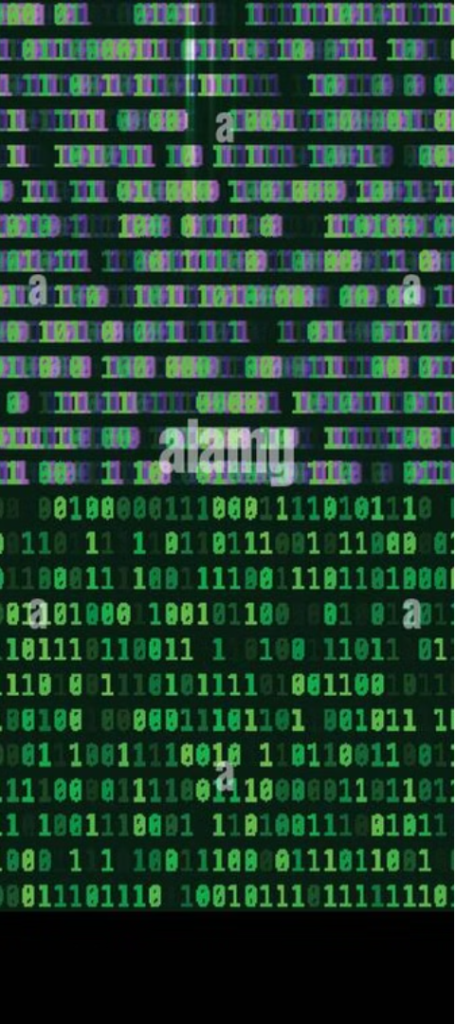
Historical Background
1
1940s-1950s
Early research in optical character recognition (OCR) laid the foundations for handwritten digit recognition.
2
1960s-1970s
The development of neural networks and machine learning algorithms paved the way for more advanced digit recognition systems.
3
1990s-2000s
Increased computational power and the availability of large datasets enabled the rise of deep learning-based digit recognition models.

Slide 5
Advantages of Handwritten Digit Recognition
Improved Efficiency
Enhanced Accuracy
Versatile Applications
AI-powered digit recognition can process large volumes of handwritten data quickly and accurately, streamlining tasks and improving productivity.
Advanced AI algorithms can achieve high levels of precision in identifying digits, reducing errors and improving the reliability of data processing.
Handwritten digit recognition has a wide range of applications, from banking and finance to logistics and healthcare, making it a valuable tool in various industries.

Slide 6
Hyperparameter Tuning
Learning Rate
Batch Size
Network Architecture
Determines the step size during training, balancing convergence speed and stability.
Affects the quality of gradient estimates and the overall training process.
The number and size of layers in the neural network can significantly impact performance.

Slide 7
Data Augmentation
1
Rotation
2
Scaling
Applying random rotations to training images to improve model robustness.
Resizing training images to create variations in size and perspective.
3
Noise Addition
4
Elastic Deformation
Introducing controlled noise to simulate real-world imperfections in handwritten digits.
Applying random elastic transformations to mimic the natural variability of handwriting.

Slide 8
Machine Learning Approaches
Supervised Learning
Deep Learning
Supervised learning models, such as Support Vector Machines (SVMs) and Random Forests, have been widely applied to handwritten digit recognition. These models learn from labeled training data to accurately classify new digit samples.
Convolutional Neural Networks (CNNs) have emerged as the state-of-the-art approach for handwritten digit recognition. These deep learning models can automatically extract relevant features from raw pixel data and achieve remarkable classification accuracy.

Slide 9





How Handwriting Works using AI
Input
A user provides a handwritten digit image.
Preprocessing
The image is cleaned and normalized.
Feature Extraction
Key features are extracted from the image.
Classification
The extracted features are compared to a trained model to identify the digit.
Output
The recognized digit is displayed.

Slide 10

Preprocessing and Normalization of Handwritten Digits
1
Binarization
2
Resizing
Converting the grayscale input image to black and white for better feature extraction.
Normalizing the size of the digit to a standard input size for the neural network.
3
Centering
4
Noise Removal
Ensuring the digit is properly aligned within the input image.
Eliminating background noise and irregularities to improve model performance.

Slide 11




Overview of Digit Recognition Task
Digit Extraction
Isolating individual digits from the input image or document, often involving image segmentation techniques.
Feature Extraction
Identifying distinctive characteristics of each digit, such as shape, stroke patterns, and spatial relationships.
Classification
Applying machine learning models to classify the extracted digits into their corresponding numeric values (0-9).

Slide 12



Dataset Preparation and Preprocessing
Data Collection
1
Gather handwritten digit samples from various sources
Image Preprocessing
2
Normalize pixel values, resize, and convert to grayscale
Augmentation
3
Apply transformations like rotation, scaling, and shearing to increase dataset size
Preparing a high-quality dataset is crucial for successful handwritten digit recognition. This involves carefully collecting a diverse set of handwritten digit samples, performing necessary preprocessing steps like normalization and grayscale conversion, and applying data augmentation techniques to expand the dataset and improve model generalization.

Slide 13
Model Training and Evaluation
Dataset Preparation
1
Clean, normalize and augment the handwritten digit dataset.
Model Architecture
2
Design a robust Convolutional Neural Network (CNN) architecture.
Hyperparameter Tuning
3
Optimize model hyperparameters through rigorous experimentation.
With the preprocessed dataset in hand, we train our custom CNN model from scratch. This involves carefully designing the network architecture, selecting appropriate hyperparameters, and leveraging techniques like data augmentation to improve generalization. We then thoroughly evaluate the trained model's performance on held-out test data to assess its effectiveness at recognizing handwritten digits.

Slide 14
Reference
gLeCun, Y., Bottou, L., Bengio, Y., & Haffner, P. (1998). "Gradient-based learning applied to document recognition." Proceedings of the IEEE, 86(11), 2278-2324.
Lecun, Y., Bengio, Y., & Hinton, G. (2015). "Deep learning." Nature, 521(7553), 436-444..
Cireşan, D. C., Meier, U., Gambardella, L. M., & Schmidhuber, J. (2010). "Deep, big, simple neural nets for handwritten digit recognition." Neural Computation, 22(12), 3207-3220
Goodfellow, I., Bengio, Y., & Courville, A. (2016). "Deep Learning." MIT Press..

Slide 15
Real-World Applications and Future Directions
Financial Applications
Assistive Technology
Handwritten digit recognition is crucial for processing checks, invoices, and other financial documents to automate data entry and improve efficiency in banking and accounting.
Digit recognition can enable assistive devices to interpret handwritten input from users with physical disabilities, improving accessibility and independence.
Document Digitization
Future Advancements
Accurate handwritten digit recognition is key for converting historical documents and forms into digital formats, preserving valuable information.
As deep learning techniques continue to advance, researchers are exploring ways to improve generalization, robustness, and real-time performance of handwritten digit recognition models.

Slide 16
Future Advancements and Applications
Improved AI Models
Integrating with IoT
Combining handwritten digit recognition with the Internet of Things (IoT) can enable real-time data processing and decision-making in various industries.
Ongoing research in deep learning and neural networks will lead to more accurate and versatile handwritten digit recognition systems.
Expanding Applications
As the technology advances, handwritten digit recognition will find new applications in areas such as education, healthcare, and smart city development.

Slide 17

Conclusion and Future Research Directions
This technology enables practical applications in areas such as automated data entry, postal services, banking, and education, demonstrating the power of AI in transforming and automating complex recognition tasks.

